Slide 1
DIABETIC RETINAL IMAGE CLASSFICATION
USING DEEP LEARNING
Guided by,
Mr. K.SUNDARAMOORTHI., M.Sc., M.Phil.,
Assistant Professor
Department of Computer Science
Presented By,
R.ABINISHA

Slide 2
CONTENTS
Abstract
Introduction
Literature Survey
Existing system
Proposed system
Software Requirement
Hardware Requirements

Slide 3
ABSTRACT
ABSTRACT
Diabetic retinopathy is a serious complication of diabetes and a leading cause of blindness in adults. early detection and diagnosis of this condition through retinal image analysis can significantly improve patient outcomes. in this study, we present a deep learning-based approach for the automated classification of retinal images as either "diseased" or "normal" based on the presence or absence of diabetic retinopathy.
The core of our approach lies in leveraging a convolutional neural network (cnn) architecture trained on a large dataset of label retinal images. we utilize transfer learning techniques, fine-tuning a pre-trained cnn model to adapt to the specific features relevant to diabetic retinopathy detection. the model is trained using a combination of retinal images annotated by medical professionals.
Once trained, the model is capable of making predictions on unseen retinal images. for each input image, the model outputs a probability score indicating the likelihood of diabetic retinopathy being present. we threshold this probability to classify images as either "diseased" or "normal".

Slide 4
INTRODUCTION
DATA COLLECTION:
Acquiring a comprehensive dataset of retinal images is critical for training and evaluating the classification model. this dataset should encompass a wide range of retinal conditions, including different stages of diabetic retinopathy, as well as images of healthy retinas for comparison. the data collection process involves several steps:
Source selection
Annotation
Data augmentation
Data quality assurance

Slide 5
EXISTING SYSTEM
EXISTING SYSTEM:
The Existing System For Diabetic Retinal Image Classification May Involve Manual Inspection Of Retinal Images By Ophthalmologists Or Trained Medical Professionals.
Manual Examination
Grading And Diagnosis
Decision Making
Advantage:expertise, Accuracy
Disadvantage: Subjectivity, Time-consuming, Resource Intensive

Slide 6
PROPOSED SYSTEM
PROPOSED SYSTEM:
The Proposed System Uses Deep-learning To Automatically Learn The Intrinsic Features From Various Scanned Images. Our Experimental Results Show That High Accuracy Can Be Achieved For Source Scanner Identification. The Proposed System Can Also Generate A Reliability Map That Indicates The Manipulated Regions In An Scanned Image.
Advantages:
Efficiency,consistency, Accessibility
Disadvantages:
Algorithmic Bias, Interpretability ,Validation And Regulation

Slide 7
Modules
1.Load Dataset:
Load Data Set Using Pandas Read_csv() Method.
2.Split Data Set:
Split The Data Set To Two Types. One Is Train Data Test And Another One Is Test Data Set.
3.Train data set:
Train Data Set Will Train Our Data Set Using Fit Method.
4.TEST DATA SET:
Test Data Set Will Test The Data Set Using Algorithm.
5.Predict data set:
Predict() Method Will Predict The Results.

Slide 8
Software Requirements Specifications
Hardware requirement
Memory - 8GB RAM
Intel I5 Core Processor
Hard Disk : 250 Gb
Software requirement
Operating System: windows, linux
Python i3.7

Slide 9
SYSTEM DESIGN
Load image
Preprocess image
Train the model
Save that model
Run the main program
Upload the image
Visualization

Slide 10
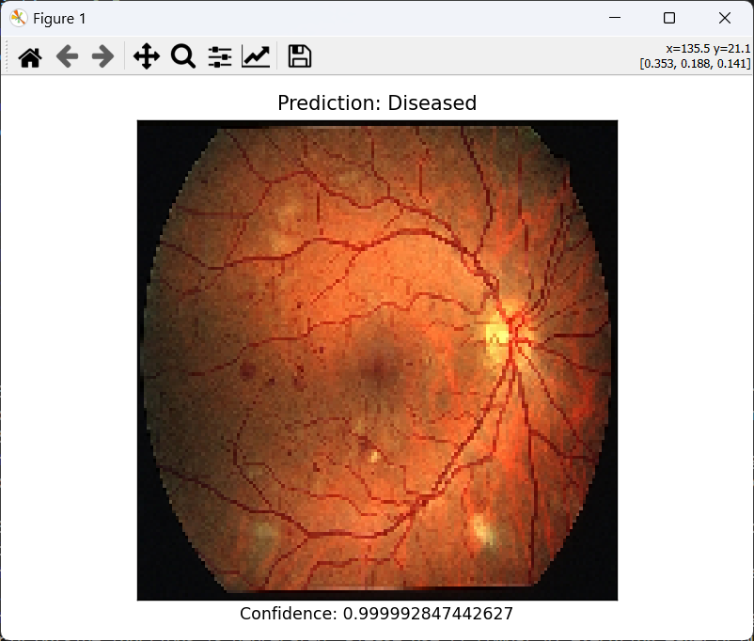
OUTPUT IMAGE

Slide 11
CONCLUSION
The Imbalance Between Diseased And Normal Retinal Images In The Dataset Can Pose Challenges For Model Training And Evaluation, Requiring Techniques Such As Oversampling, Under Sampling, Or Class Weighting To Address. Deep Learning Models Are Often Perceived As Black Boxes, Making It Challenging To Interpret Their Decisions. Developing Methods For Explaining Model Predictions, Such As Attention Mechanisms Or Saliency Maps, Can Enhance Trust And Adoption By Healthcare Professionals.

Slide 12
REFERENCES
[1] N. Abbas, T. Saba, D. Mohamad, A. Rehman, A. Almazyad, And J. Saleh Al-ghamdi, “Machine Aided Malaria Parasitemia Detection In Giemsastained Thin Blood Smears,” Neural Computing And Applications, Vol. 29, No. 3, P. 803–818, 2016. [2]
A. Capone, I. Ricci, C. Damiani, M. Mosca, P. Rossi, P. Scuppa, E. Crotti, S. Epis, M. Angeletti, M. Valzano, L. Sacchi, C. Bandi, D. Daffonchio, M. Mandrioli, And G. Favia, “Interactions Between Asaia, Plasmodium And Anopheles: New Insights Into Mosquito Symbiosis And Implications In Malaria Symbiotic Control,” Parasites & Vectors, Vol. 6, P. 182, 2013.
WEB REFERENCE
www://.w3schools.com/
www://python.org
www://docs.python.org

Slide 13
THANK YOU

